Slide 1


Features and decision regions
=============================================================================
WWW.THEMLLABS.COM || contact@themllabs.com || Phone : 91-7338339898, 91-6362546088

Slide 2
Agenda
Features
Decision regions
=============================================================================
WWW.THEMLLABS.COM || contact@themllabs.com || Phone : 91-7338339898, 91-6362546088

Slide 3
Features
Features is any column in the given input matrix, it will be used as an independent variable.
Features are elements of the input vectors.
Number of features is equal to the number of nodes in the input layer of the neural network.
=============================================================================
WWW.THEMLLABS.COM || contact@themllabs.com || Phone : 91-7338339898, 91-6362546088

Slide 4
Features can be taken directly from source data or you can apply some transformation, which is appropriate for modelling.
For example, if you want to classify the person as either men or women, then height, weight, hair length are the features for the network.
=============================================================================
WWW.THEMLLABS.COM || contact@themllabs.com || Phone : 91-7338339898, 91-6362546088

Slide 5
Decision region
Decision region or decision surface is the region of a problem space where the output label of the classifier is ambiguous.
For a problem with 2 classes, the decision region is hyper surface that partitions the vector space into two sets, one for each class.
If the decision region is hyperplane, then the classification problem is linear and those classes can be separated linearly.
=============================================================================
WWW.THEMLLABS.COM || contact@themllabs.com || Phone : 91-7338339898, 91-6362546088

Slide 6
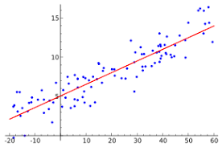
Decision boundaries results are not clear always.
Below figure is example for decision region with two classes
=============================================================================
WWW.THEMLLABS.COM || contact@themllabs.com || Phone : 91-7338339898, 91-6362546088

Slide 7
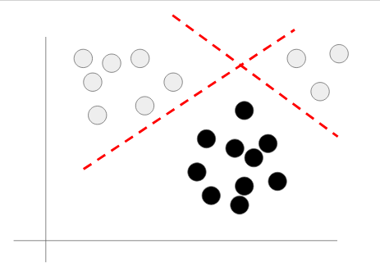
For non-linear decisions, we can use either multiple lines boundaries or curves to classify the classes.
=============================================================================
WWW.THEMLLABS.COM || contact@themllabs.com || Phone : 91-7338339898, 91-6362546088

Slide 8
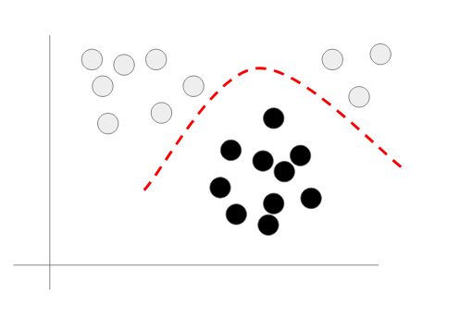
The previous figure contains points which are not separated by a line, so using two lines the white and black points are separated. Consider another way of separating the classes.
=============================================================================
WWW.THEMLLABS.COM || contact@themllabs.com || Phone : 91-7338339898, 91-6362546088

Slide 9
The points ae separated by a curve (a non linear boundary).
In neural network , we can think each hidden node as a linear decision boundary, the network can combine them to form nonlinear boundaries.
The previous figure produced the results for a network with 2 hidden nodes.
=============================================================================
WWW.THEMLLABS.COM || contact@themllabs.com || Phone : 91-7338339898, 91-6362546088

Slide 10
Thank you
=============================================================================
WWW.THEMLLABS.COM || contact@themllabs.com || Phone : 91-7338339898, 91-6362546088

